Slide 1
SuperPower Vision Group Team Training
Write a classifier from scratch
using OpenCV and Modern C++
Jiawei Liu => jaway.liu@gmail.com
2019/9/7

Slide 2
Some Basic Knowledge
/01
OpenCV: IO & Image Model & Thresholding
CMake: Basic Usage
C++: Learning Modern C++ via a custom array class

Slide 3
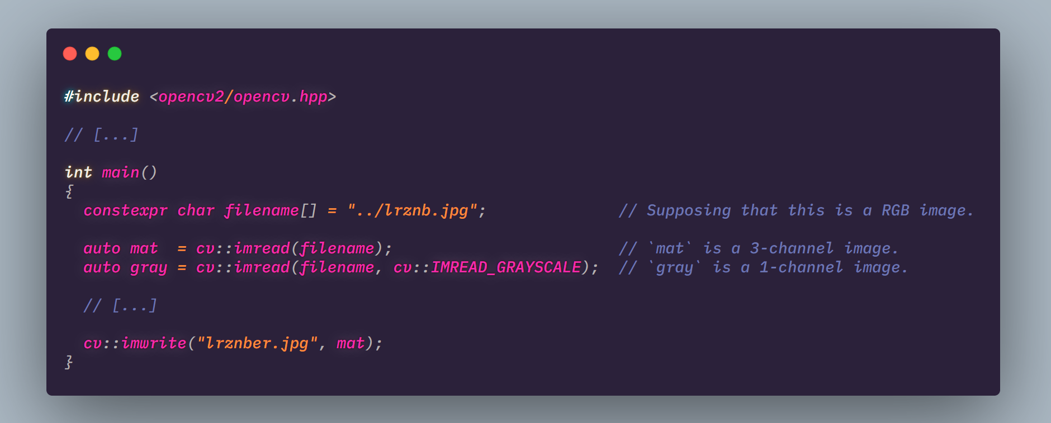
OpenCV IO
cv::Mat
Read in 3-channel by default.
In 1-channel and cvt it to gray.
https://www.ccoderun.ca/programming/doxygen/opencv/classcv_1_1Mat.html

Slide 4
cv::Mat
For image processing: BGR not RGB
(N)WHC:
N => N images
W => Width ~ Column
H => Height ~ Row
C => Channel (i.g. BGR ~ 3 channel)
CPU iteration: by rows(faster)
Continuous by row.
Everything is reference. Want a copy? Call cv::Mat::clone(). But I suggest that u’d better use reference assignment for readability and performance(cv::Mat uses a ref counting technology).
https://docs.opencv.org/3.1.0/d3/d63/classcv_1_1Mat.html

Slide 5
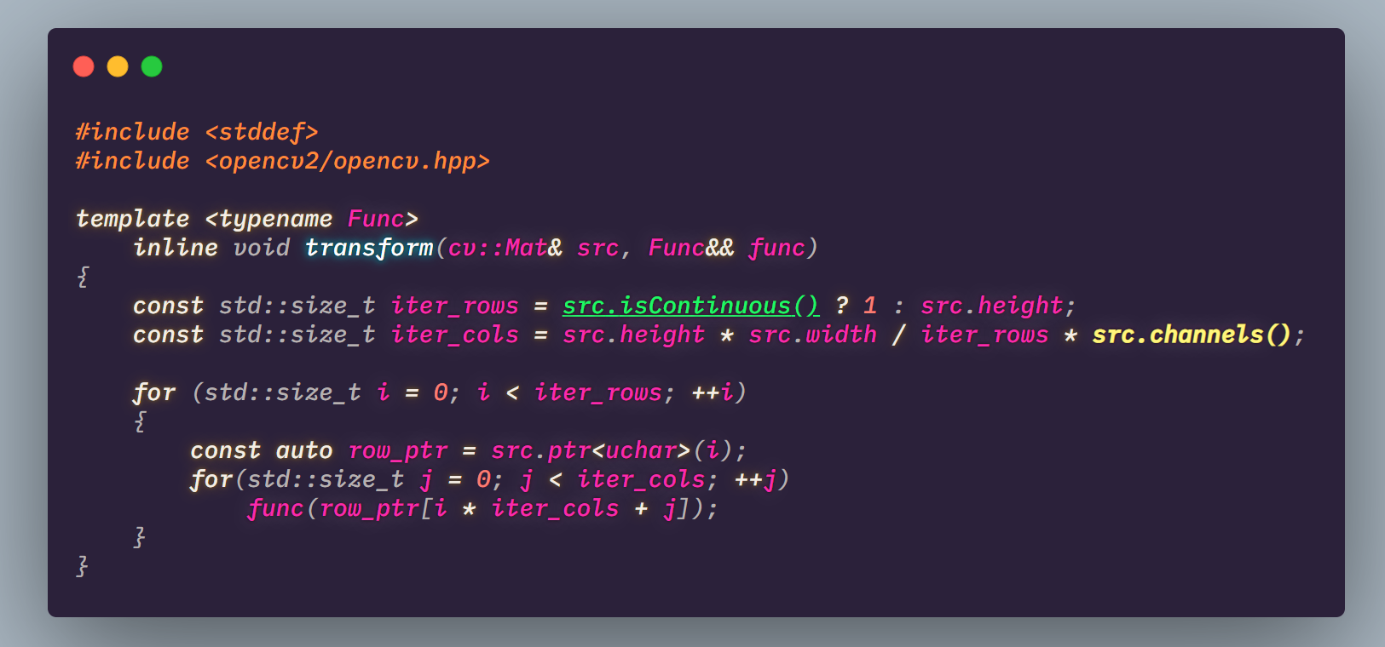
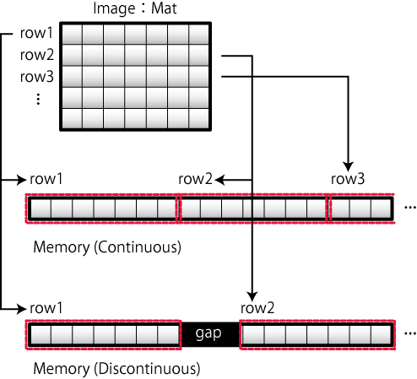
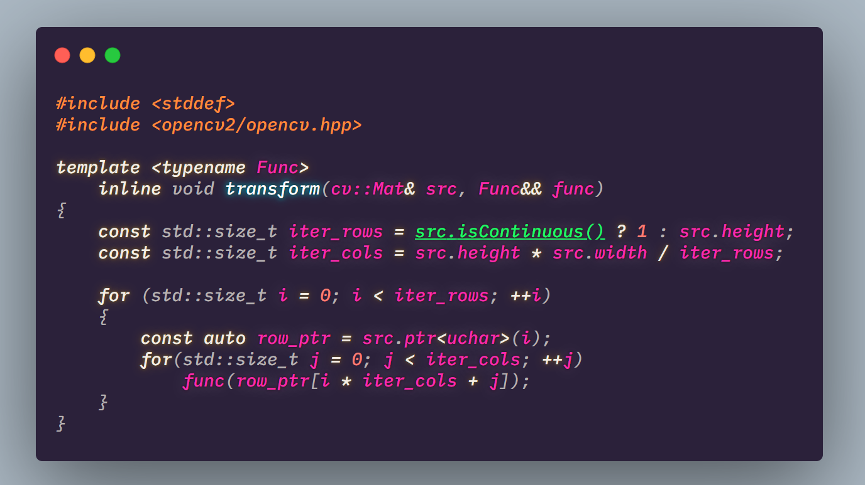
cv::Mat Iteration
Iterate each pixels of a gray image.
And apply func to them.
What about N-channel image iteration ?
http://opencv.jp/cookbook/opencv_mat.html

Slide 6
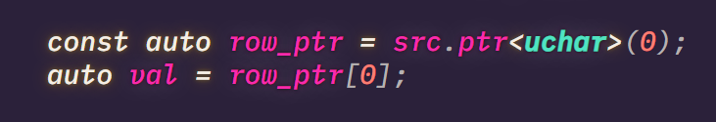
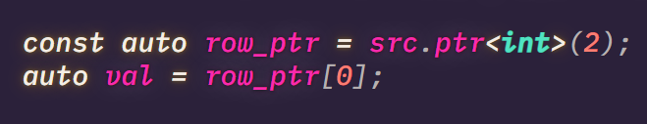
cv::Mat is just a big chunk of memory. What it is depends on how U view it.

Slide 7
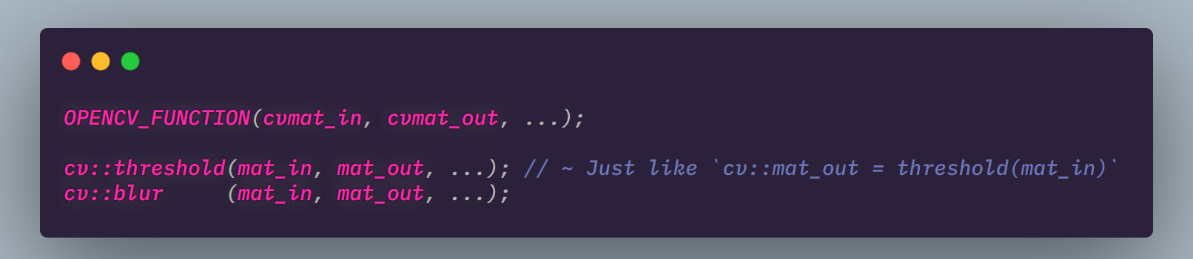
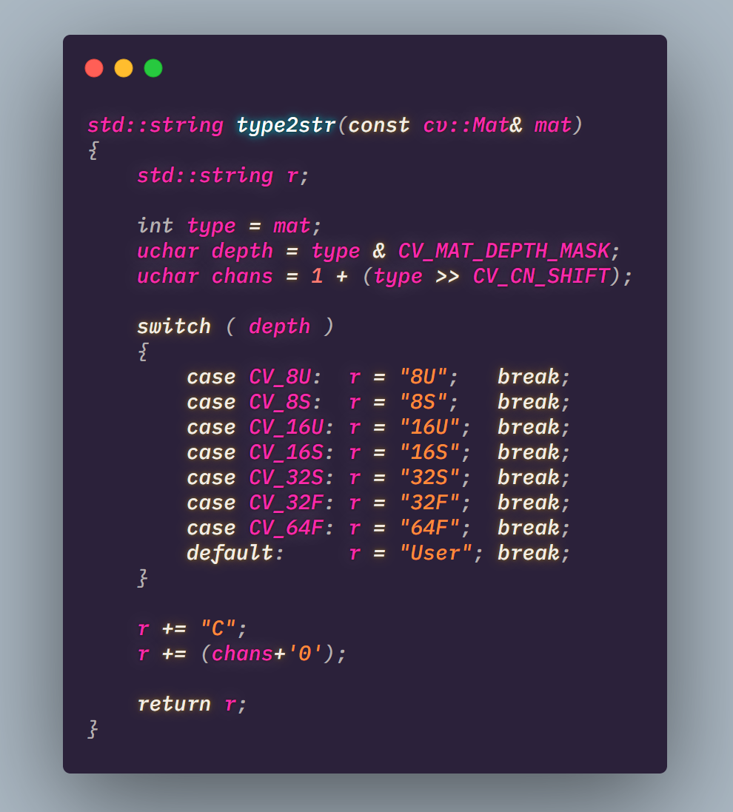
OpenCV function style
Some times U use a function and get a mat_out.
Now U may want to know how should we view this, right?

Slide 8
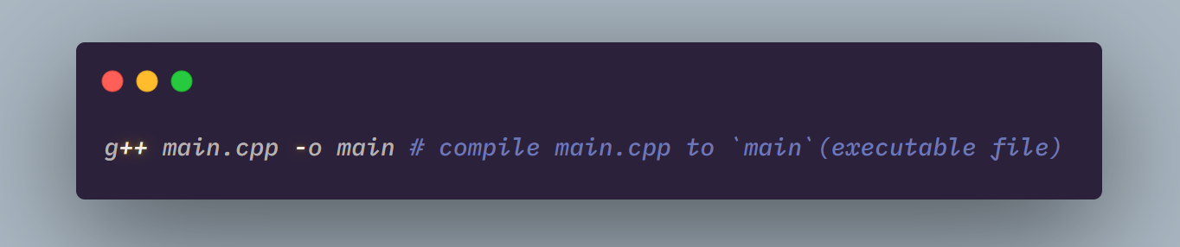
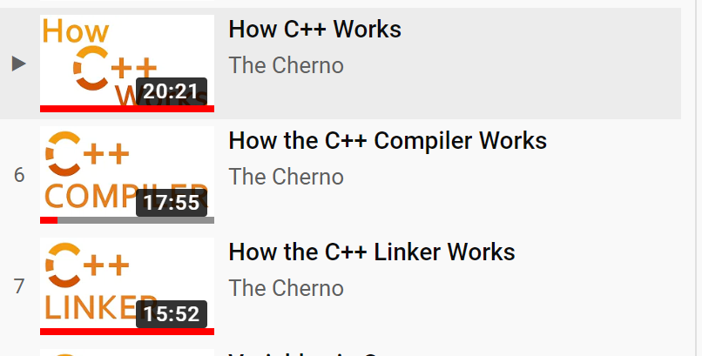
CMake Basic
This is ok if you don’t need any dependency.
What if we want use a library?
How to manage the libraries in a common way?
CMake is the answer!
To understand compiling and linking:
https://www.youtube.com/watch?v=SfGuIVzE_Os&list=PLlrATfBNZ98dudnM48yfGUldqGD0S4FFb&index=5

Slide 9
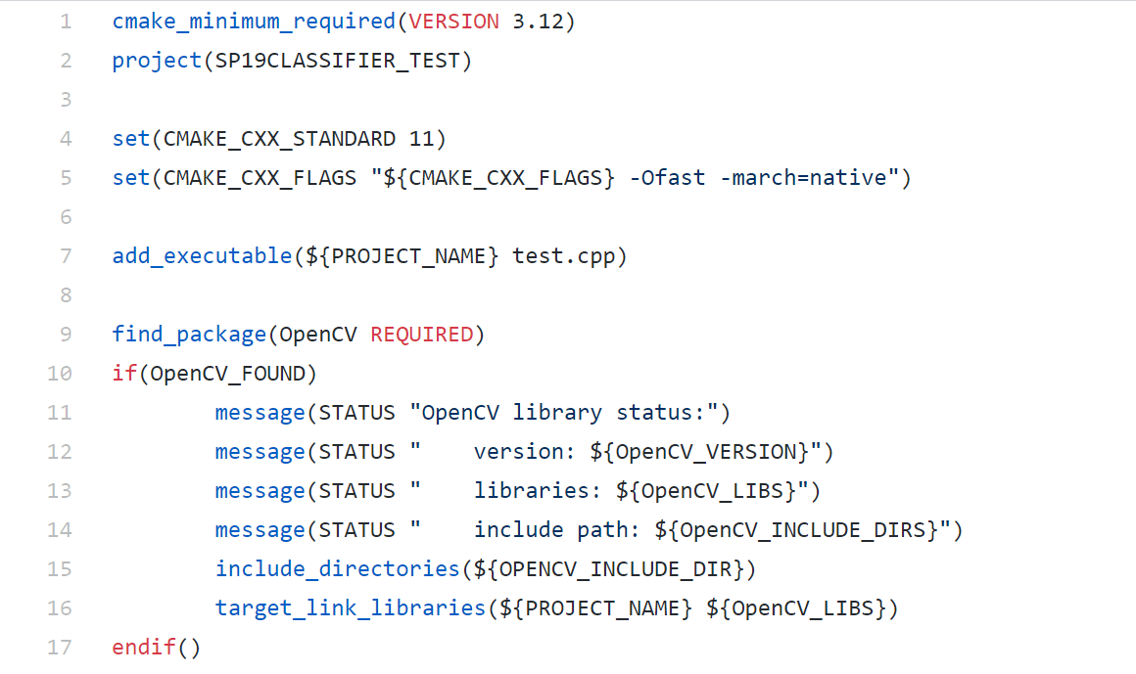
Not necessary… just cmake version.
CMake project name.(Yet u’re using CMake to build projects)
Compilation options for the compiler the CMake is using.
We want to compile test.cpp to an executable file named ${PROJECT_NAME}
${PROJECT_NAME} equals to SP19CLASSIFIER.
Try to find a package called OpenCV (REQUIRED means this library is a must)
(For OpenCV 4+ version, use find_package(OpenCV 4)).
Add package-related headers(i.g. opencv2/opencv.hpp to your project)
Link OpenCV library
https://github.com/ganler/superpower19classifier/blob/master/CMakeLists.txt Source file of this example
https://zh.wikibooks.org/zh/CMake_%E5%85%A5%E9%96%80 Perfect resource to learn Cmake
https://www.google.com/ Best practice: XXX lib CMake

Slide 10
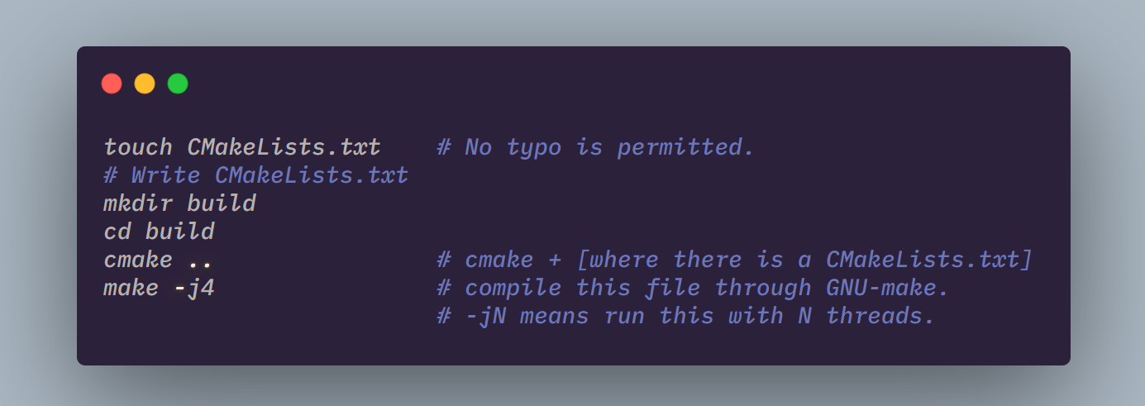
Please try to get used to this …

Slide 11
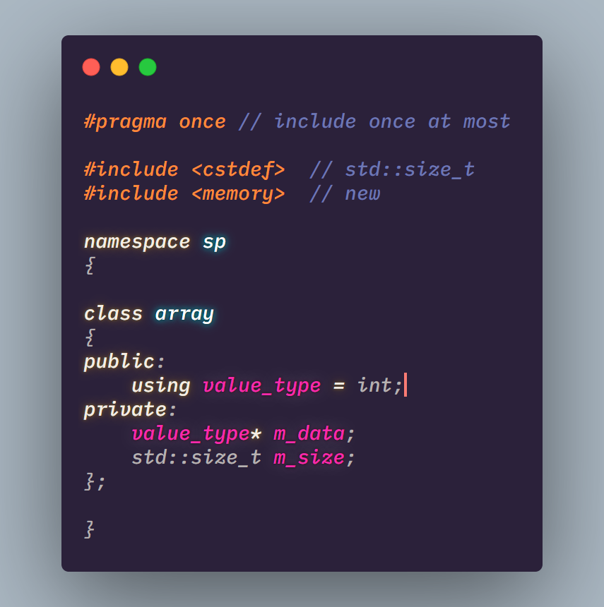
Dynamic Array Class

Slide 12
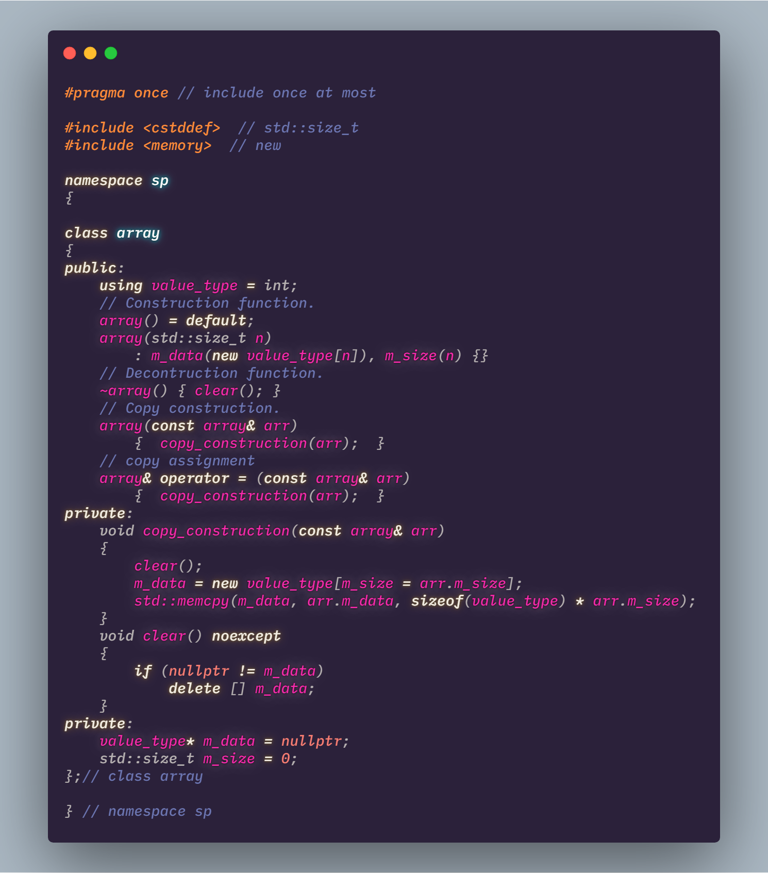
Rule of Three & RAII(Resource Acquisition Is Initialization)
资源获取即初始化（Resource Acquisition Is Initialization），或称 RAII，是一种 C++ 编程技术^{[1][2]}，它将必须在使用前请求的资源（分配的堆内存、执行线程、打开的套接字、打开的文件、锁定的互斥体、磁盘空间、数据库连接等——任何存在受限供给中的事物）的生命周期绑定与一个对象的生存期相绑定。
在构造函数中申请资源，在析构函数中释放资源。
若某个类需要用户定义的析构函数、用户定义的复制构造函数或用户定义的复制赋值运算符，则它几乎肯定三者全部都需要。
https://zh.cppreference.com/w/cpp/language/raii
https://zh.cppreference.com/w/cpp/language/rule_of_three

Slide 13
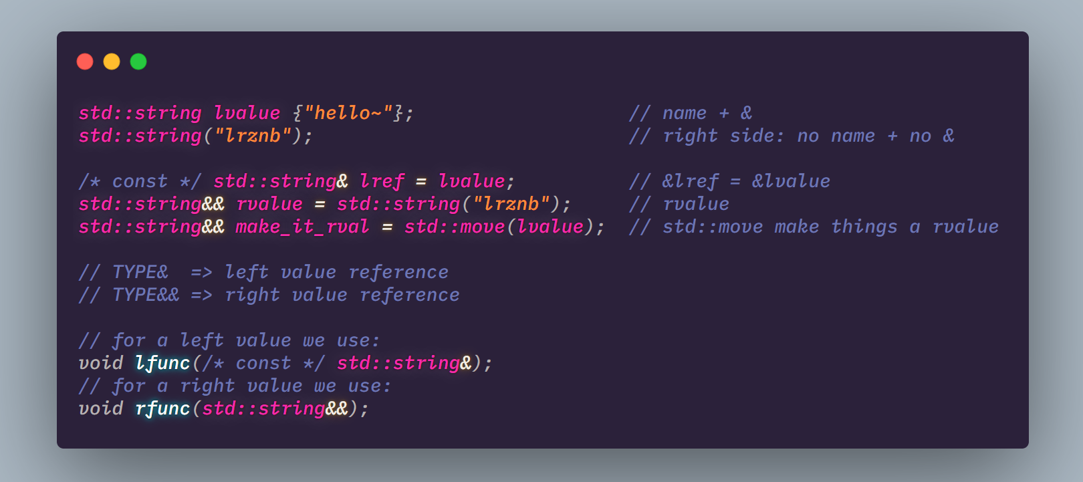
Move semantics
如果一个对象满足以下两个条件之一，即可称为左值： 1. 能取到它的地址 2. 有名字
否则叫右值。
可使用std::move将左值转化为右值。

Slide 14
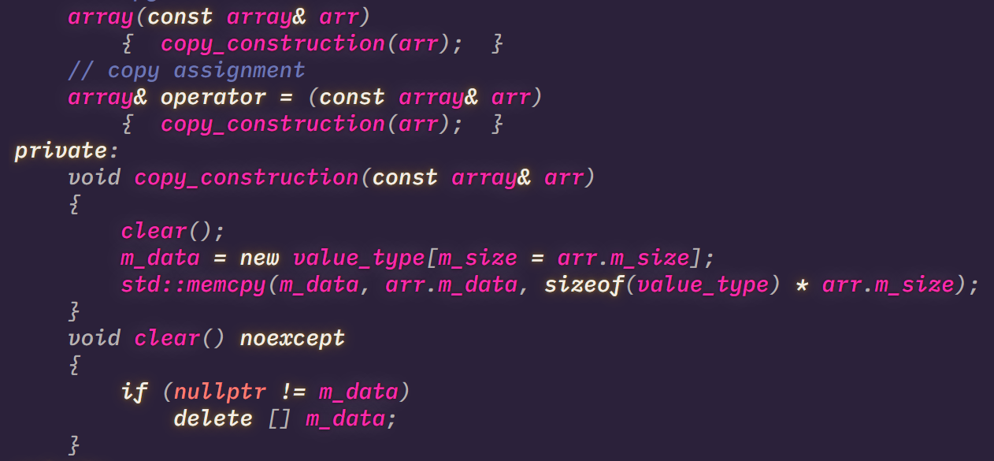
Move semantics
Now we have 2 reference type! We can do more things now.
Generally:
l-ref => copy semantics(deep copy)
r-ref => copy semantics(Give me your resource)

Slide 15
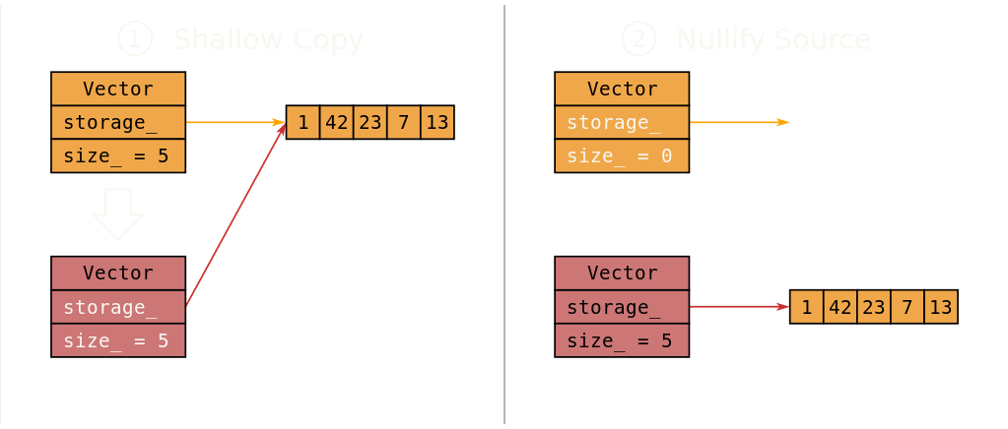
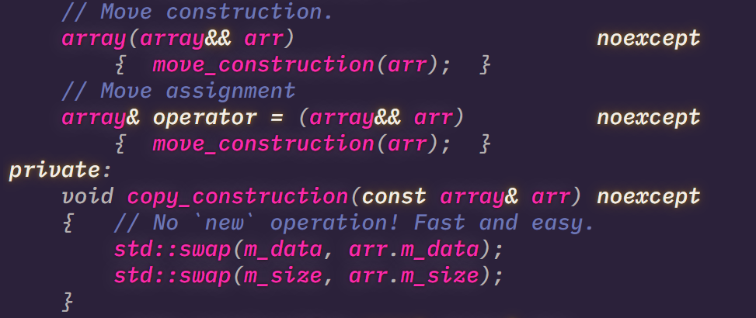
Move semantics

Slide 16
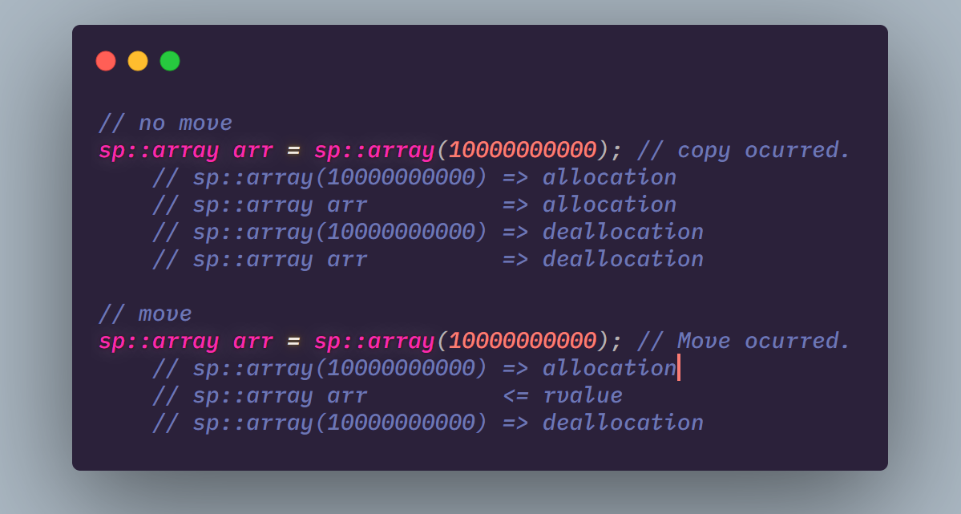
Move vs No Move

Slide 17
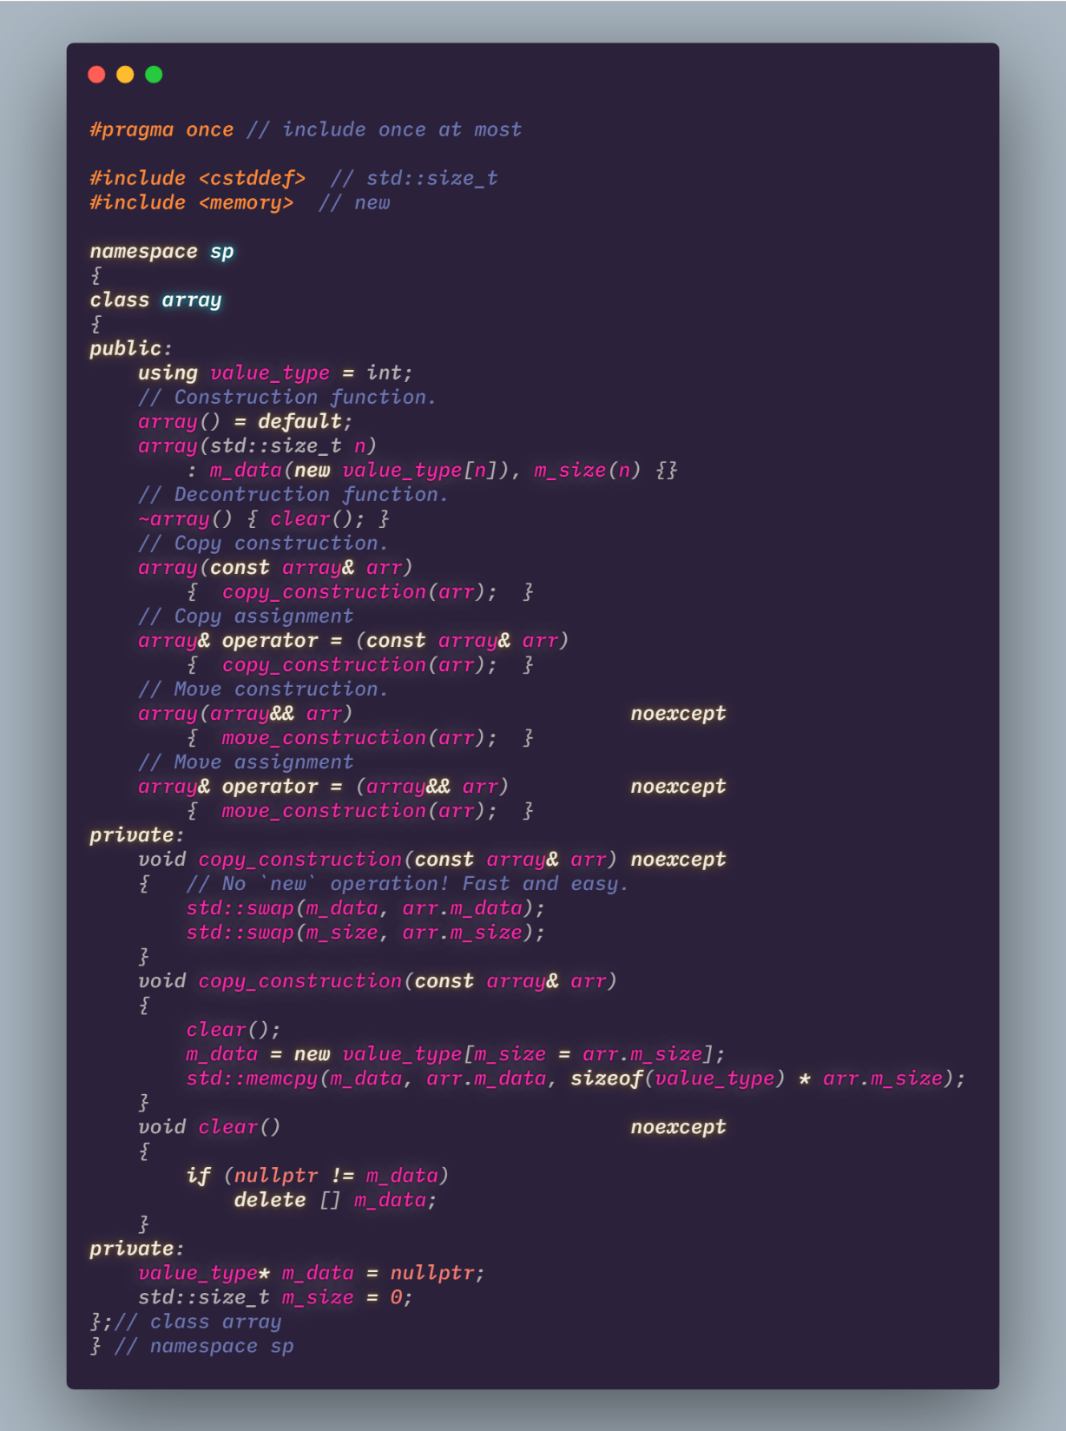
Rule of Five
Based on rule of 3:
+
Move construction.
Move assignment.

Slide 18
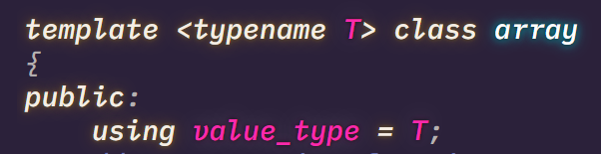
Apply this for all types – using template programming.
More than all this:
rule of zero. (self-learning)
For a header-only class, use inline for each function.
https://zh.cppreference.com/w/cpp/language/rule_of_three

Slide 19
Write a classifier
/02
General algorithm pipeline
Implementation

Slide 20


Samples
Positive sample
Positive sample
Input Image
CLASS = CLASSIFIER( )

Slide 21
Template Based Method
Positive templates
Input Image
Use some compare function to find out best-match one.
(Kind like KNN which K = 1)
Negtive templates

Slide 22
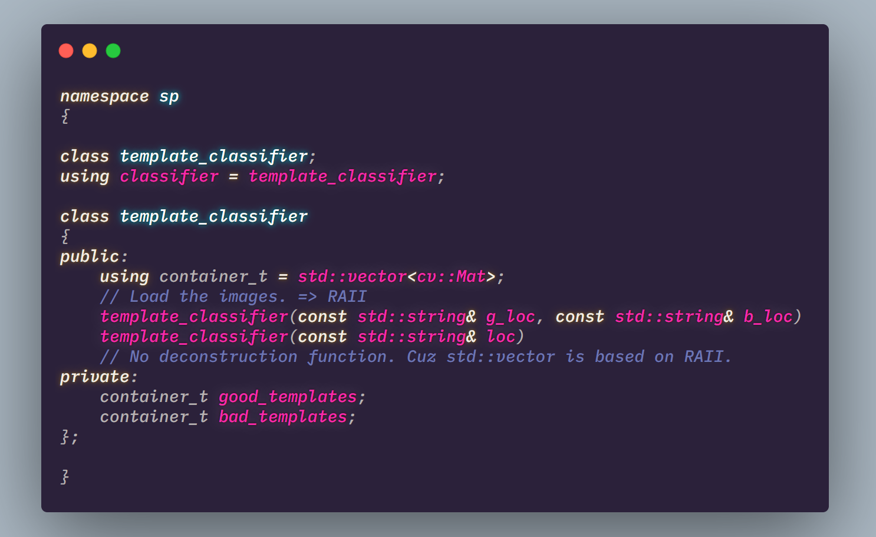
Write a classifier class

Slide 23
Forward process
sp::classifier
int forward(cv::Mat mat&)
bool boolean_forward(cv::Mat&)
Input Image
(cv::Mat)
Preprocessing
Compare each

Slide 24
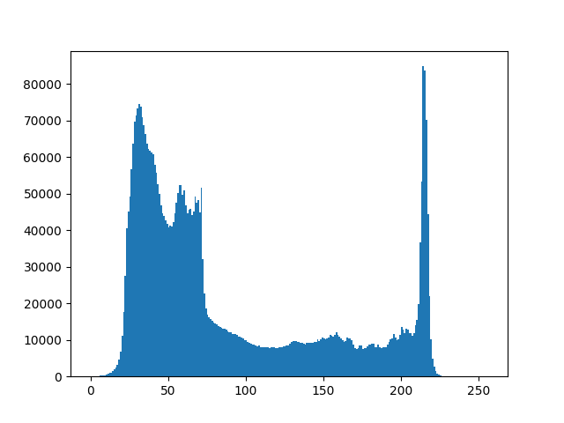
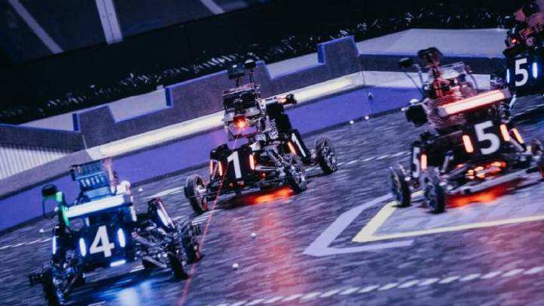
Prepare and thresholding
Light part is what we want !
About the lightest 20%~30% part.

Slide 25
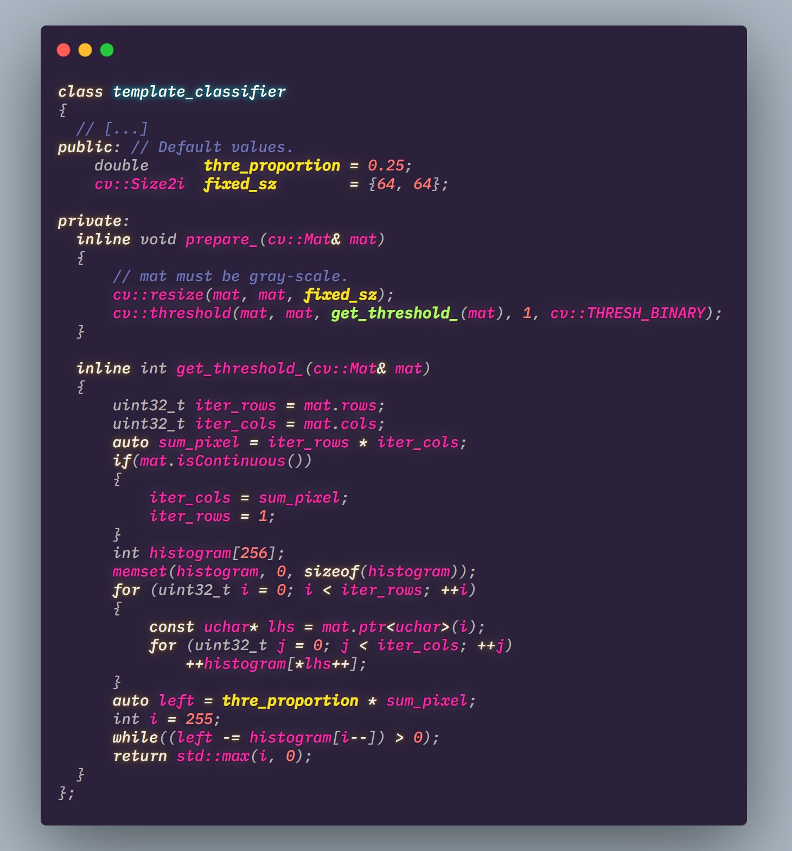
Prepare and thresholding

Slide 26
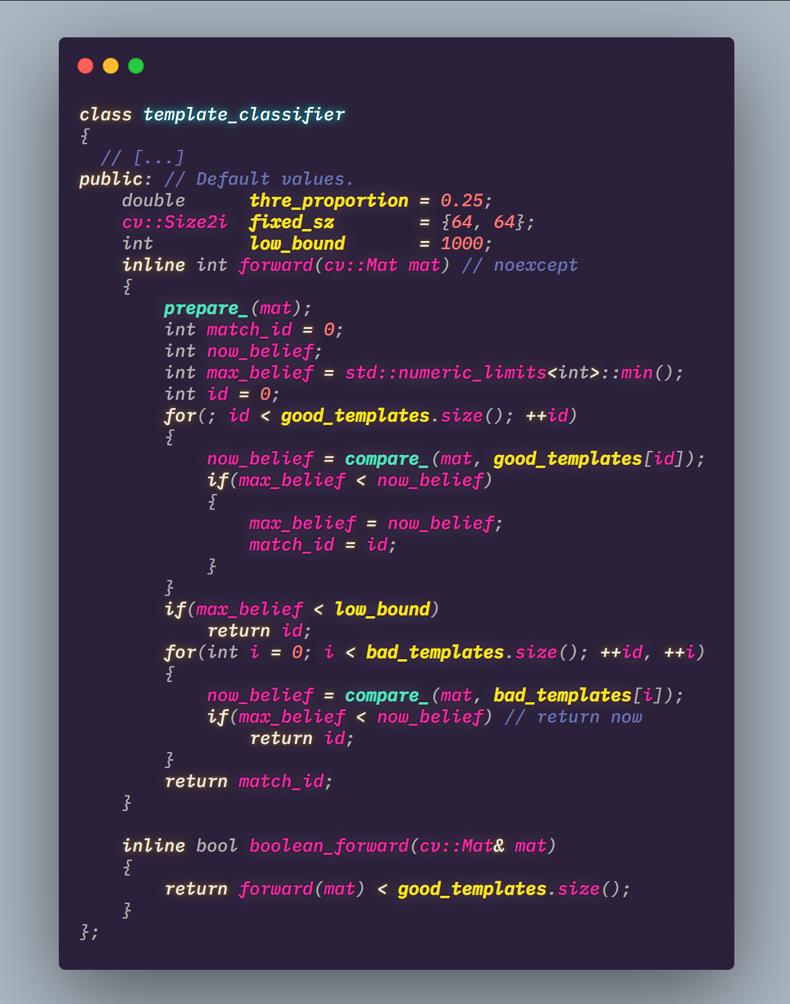
Forward
0
1
Good …
2
match_id
3
Bad …
4

Slide 27
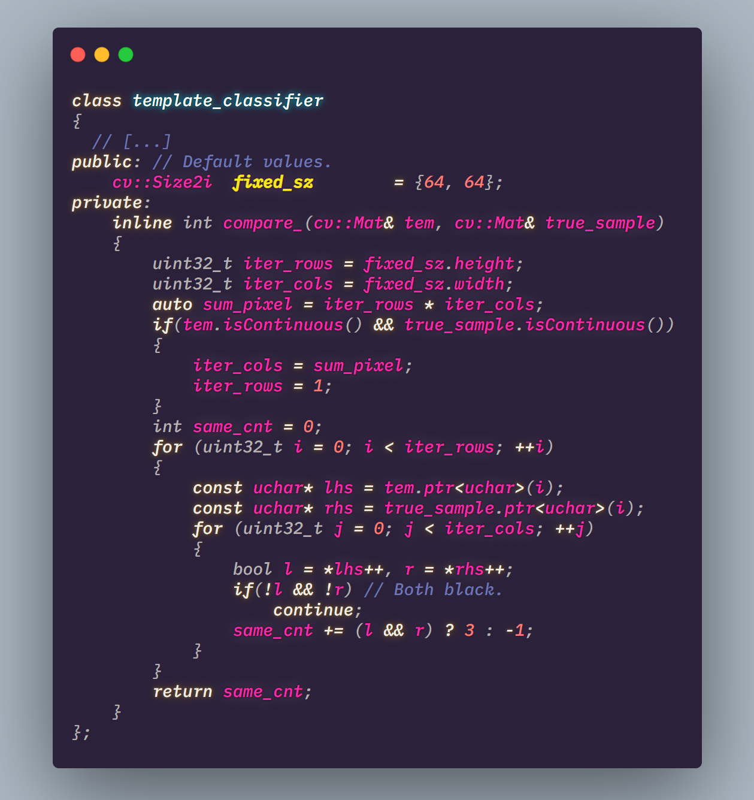
Compare input with template

Slide 28
ASSIGNMENTS
Dynamic template array2D class.
Reimplementation of sp::classifier.
Run sp::classifier using multi-threading. (optional)
DDL
2019/9/17
Notes:
iSlide，让PPT设计简单起来！
iSlide, Make PowerPoint Design Simple!

Slide 29
std::quick_exit(0);
Notes:
iSlide，让PPT设计简单起来！
iSlide, Make PowerPoint Design Simple!

